Slide 1

Yes, it’s Potato Themed
N232 – Project One
Jack Lovrinic February 13, 2024

Slide 2
Discussion 1
Throw a potato across the office because its a hot potato
Throwing works
Need to create a scene for an asset that adds a different score depending on what the sprite is, big objects, more score, small object, smaller score.
Get 5 tries, maybe have a few “extra lives or lunches” that you can throw should u hit them.
Camera follow potato until its no longer moving, then it spawns a fake potato in its place and teleports back to start position for next turn

Slide 3
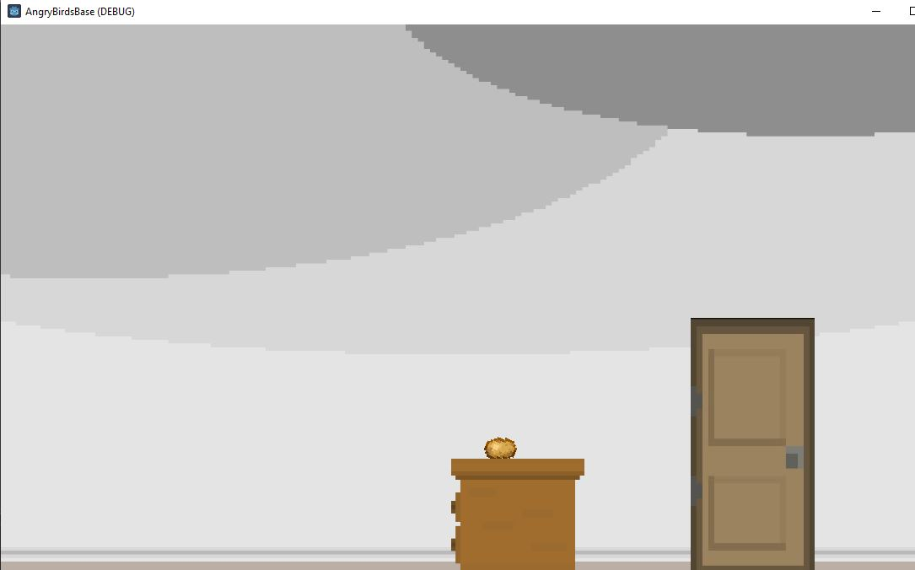
Discussion 1 – Screenshot / image

Slide 4
Discussion 1 – Question
What is something you are struggling with in your game?
I do not like going from unity to godot, I keep messing up the syntax and I dislike using underscore, exporting vars feels weird too. Workflow is super foreign right now

Slide 5
Discussion 1
Have a peer / group look through your code and comment on
File structure
Commenting / algorithm planning
Variable naming
Repetitiveness
Readability
Succinctness

Slide 6
Discussion 1
Need to work on score
Add more Objects to collide with
Music? More levels?

Slide 7
Discussion 1 –Reflection
So far I've learned how to add different important types of nodes, and utilize programming to get things to happen, whether its manipulating position, or velocity, or getting variables from different nodes. Signals can be fun, but they're probs expensive. I need to add more stuff to the game.

Slide 8
Discussion 1 –Self Assessment
Bold your self-assessment on the following areas
Code comprehension poor acceptable excellent
Code planning poor acceptable excellent
Project progress poor acceptable excellent
Variable naming poor acceptable excellent
Debugging / problem solving poor acceptable excellent

Slide 9
Discussion 2
Get other levels into the game, and have collision work properly
For some reason collision wasn't working
Figured out that it was because of contact monitoring and max contacts being set at 0
Works now

Slide 10
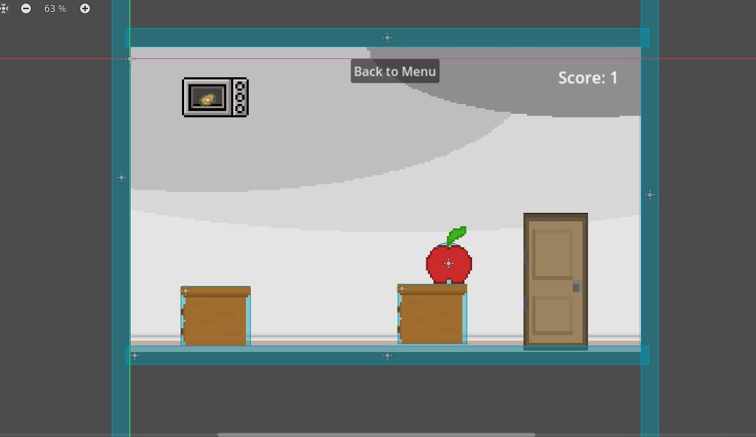
Discussion 2 – Screenshot / Image

Slide 11
Discussion 2 - Question
Getting things to instantiate properly

Slide 12
Discussion 2 -
Aesthetics:
Supposed to be office themed.
Might need some more assets to really get that across
Particle effects are cool
Could use some work regarding how bland the scenes are.

Slide 13
Discussion 2 –Reflection
To be frank, Godot has been kicking my butt. I'm used to unity by now, and every time I get in Godot I feel like I try to do something I know I can do in unity, but it just doesn't work the way I want it to in Godot.
Another unfortunate note is that Godot seems to go through changes fairly often, and often times old tutorials from a year ago, just don't work the same.
I feel like I'm just now getting the hang of it. Thank god for GameManager and AutoLoad

Slide 14
Discussion 2 – Self Asssessment
Bold your self-assessment on the following areas
Code comprehension poor acceptable excellent
Code planning poor acceptable excellent
Project progress poor acceptable excellent
Variable naming poor acceptable excellent
Debugging / problem solving poor acceptable excellent

Slide 15
P1 – Final Reflection

Slide 16
P1 – Final Reflection
Technique
I struggled a lot with getting the variables to carry over to other scripts, but AutoLoad was great and helped with that. I'm just now starting to get ahold of how Godot works.
Aesthetics
Visually my project is not very pretty. I ran out of time due to trying for way to long to get other things to work. I do like the pixel aspects though, and I think it could've been a cooler environment
Major concepts learned
I've learned how to do Particles, instantiate, audio, change scenes, public variables, and mess with physics

